Slide 1

















f
WHAT IS GOOD WELLBEING?

Slide 2


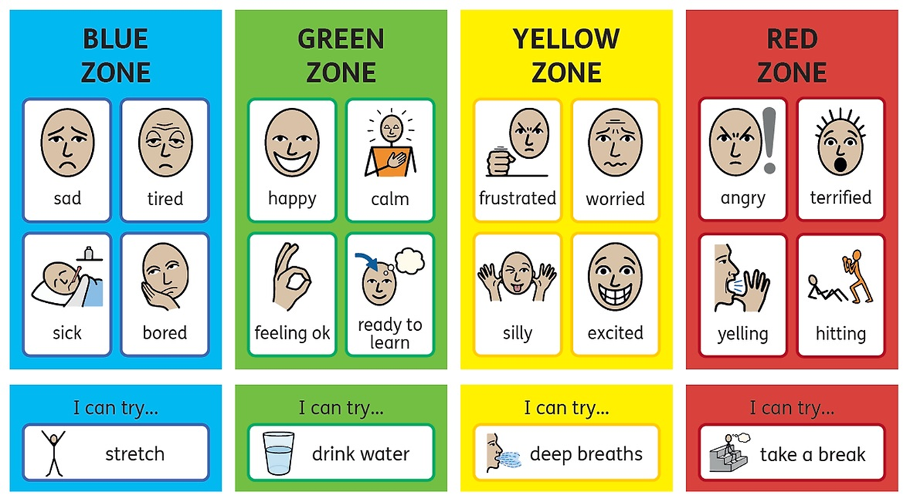


How are you?
Low energy
Good level of energy
A little too much
Too much energy

Slide 3

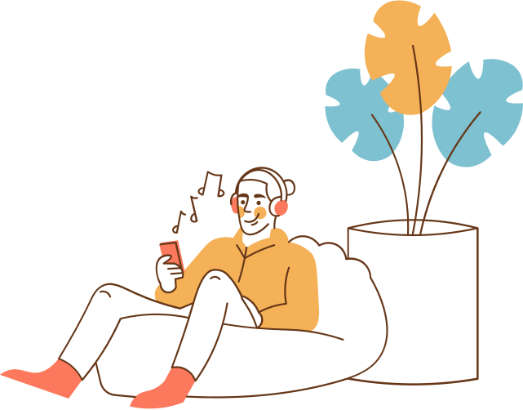
What is your favourite childhood memory?
Describe your ideal relaxing day

Slide 4
BEFORE WE START...
On a scale of 1 - 10, please rate yourself on the following statements:
1 2 3 4 5 6 7 8 9 10
Not confident
Very confident
I know the different things I can do to support my child’s wellbeing

Slide 5
What do we do?
We work in primary, secondary and colleges in Newham.
We are an early support service - helping children and their families get quick wellbeing support.
Primary schools:
  1-1 work with parents of children aged 5-11
    Children’s common fears & worries
    Common behaviour problems
  Parent workshops focused on children wellbeing
  Support staff training
  Work with children as a whole class to learn about emotions

Slide 6
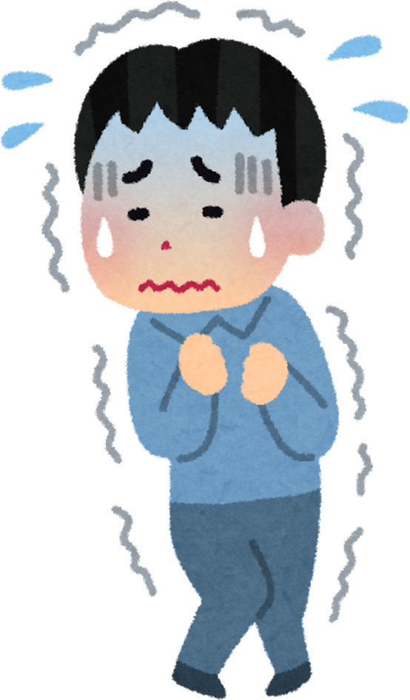
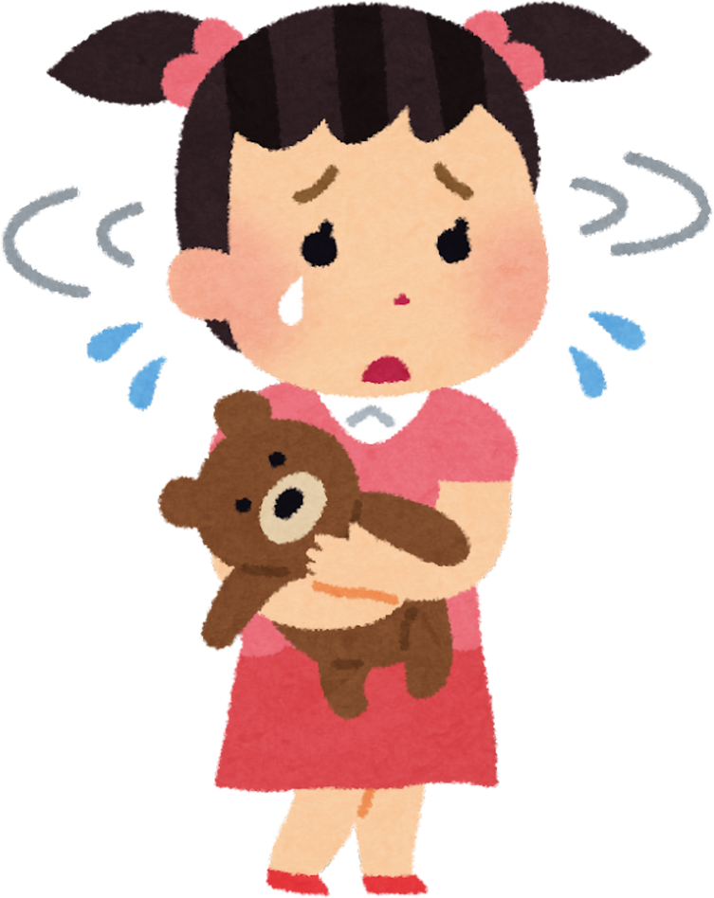
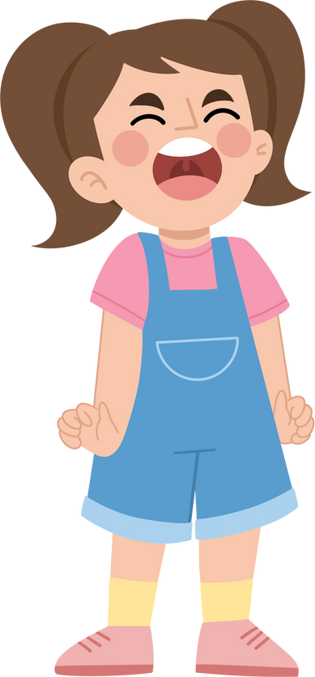
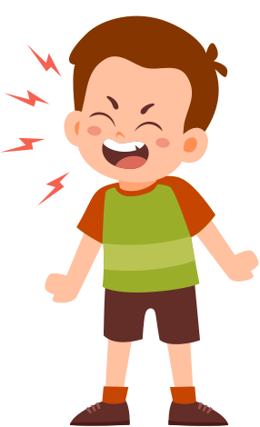
common behaviours:
•Temper tantrums
•Not following rules and instructions
Anxiety: fears & worries
•Scared of the dark / animals
•Mild fears and phobias (not needle phobia)
•Feeling generally panicky
•Feeling nervous or worried
•Lacking confidence

Slide 7
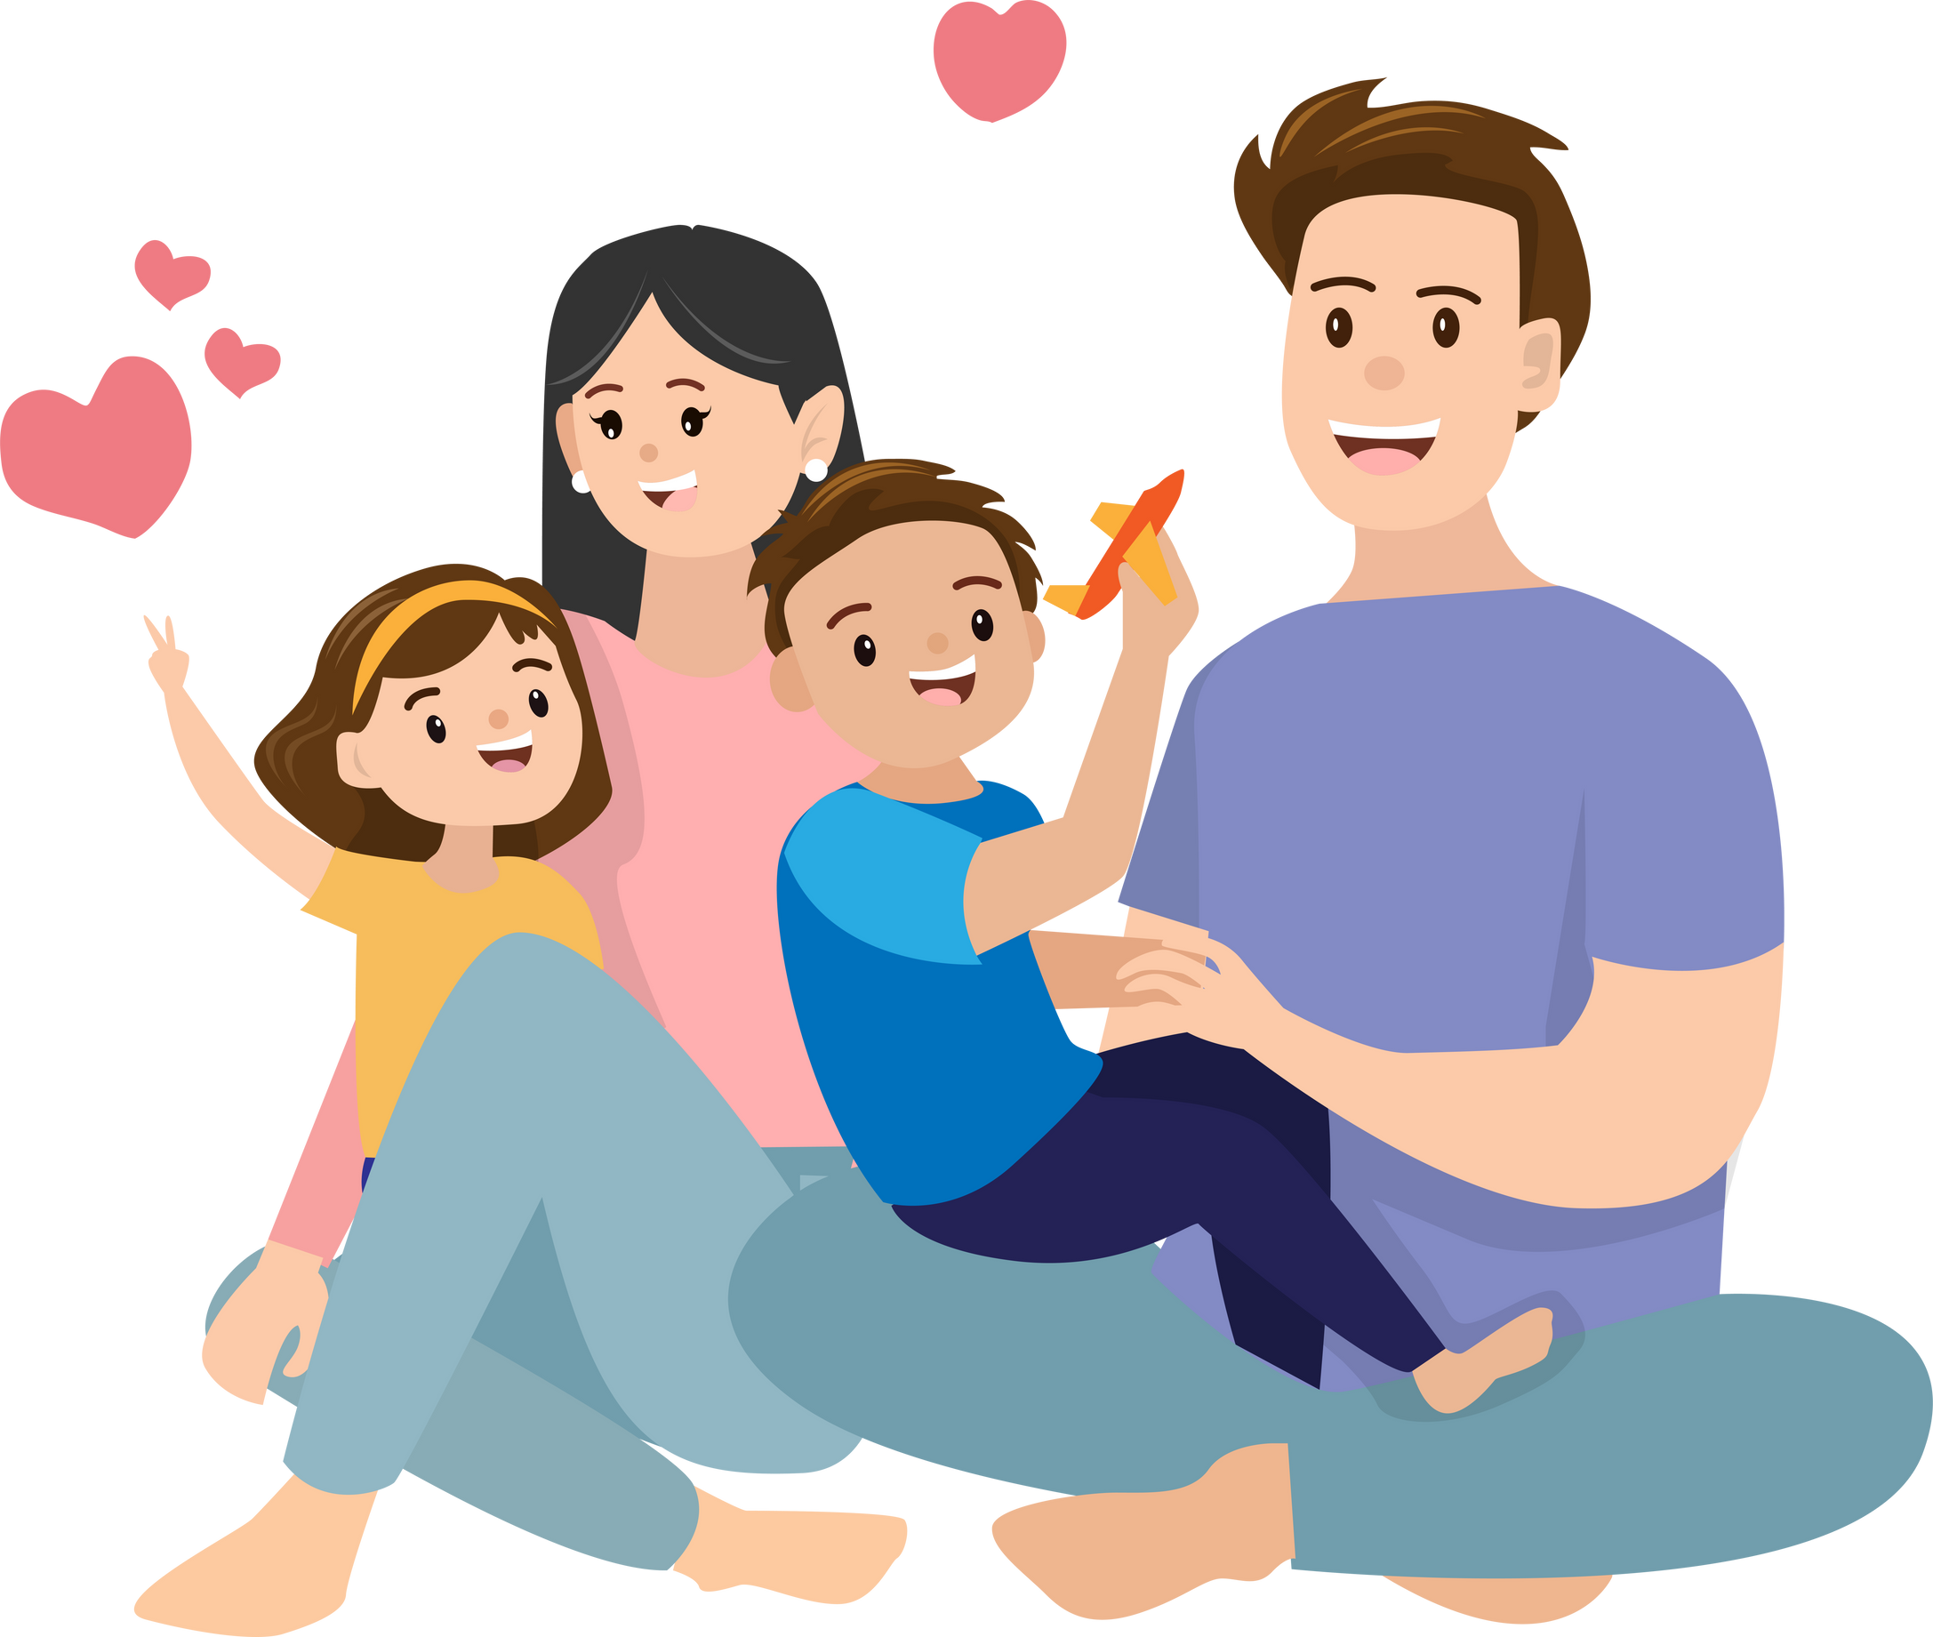
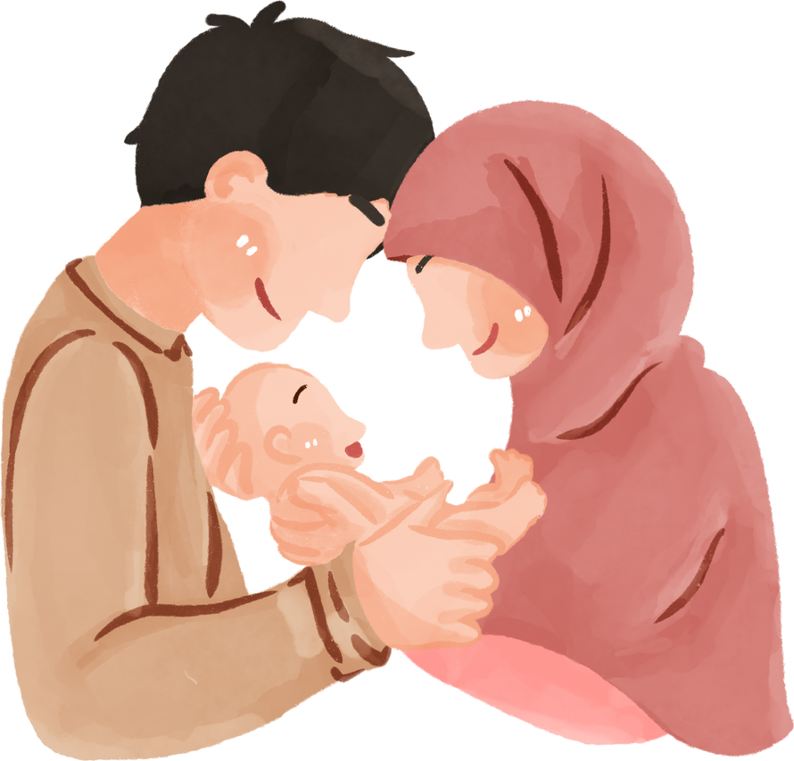
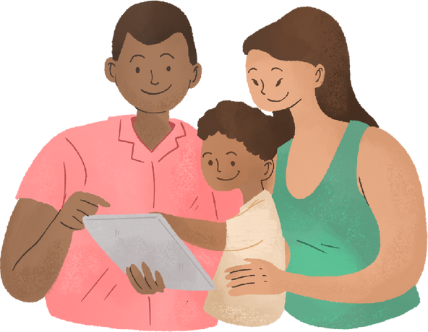
Why we work directly with parents/Carers?
  You know your child best!
  Parents are more motivated to make changes than the child.
  Parents and carers can help the whole family by putting strategies in place.
  You are likely to remember helpful tips and ask important questions.
  Research shows that parent programmes can be effective in supporting their child’s difficulties

Slide 8






















Organisations and Services

Slide 9


What does wellbeing mean to you?

Slide 10


WHAT IS WELLBEING?
  Good quality of life
  Linked to happiness and life satisfaction - how you feel about yourself and your life
  “Positive state of mind and body, including social and psychological wellbeing” - UK Government
  Supports good relationships
  Improved health, ability to cope with challenges, good health
  Feeling in control and living life with meaning

Slide 11


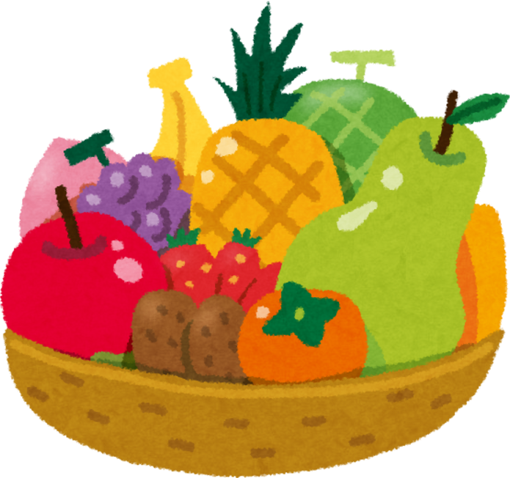

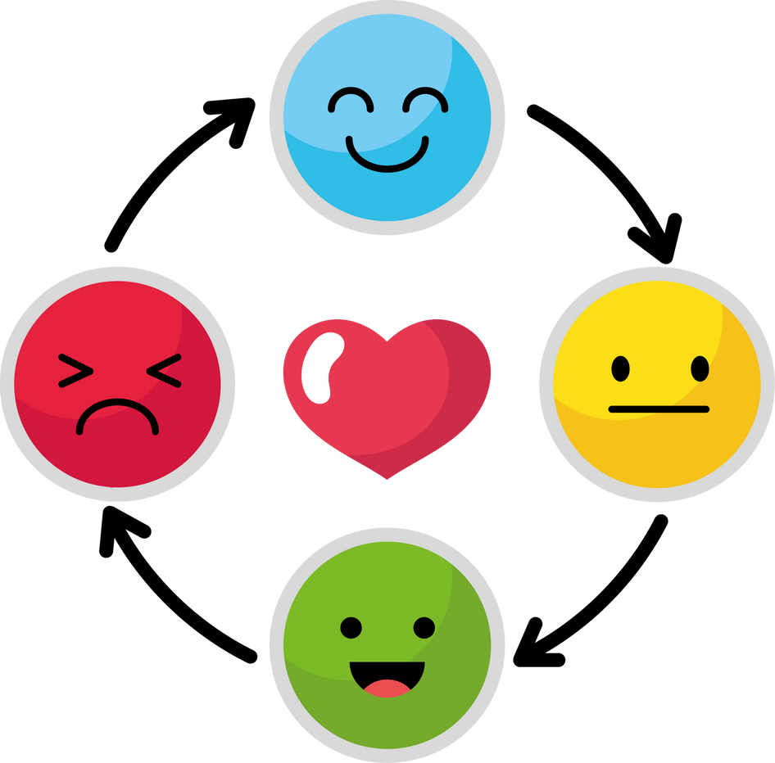


ENVIRONMENTAL
PHYSICAL
NUTRITION
Types of WELLBEING
EMOTIONAL
SPIRITUAL
SOCIAL
FINANCIAL
Notes:
Environmental – interacting with nature (parks, walking) and creating a relaxing and enjoyable work/study/living environment
Physical – physical activity, mindful of your surroundings, taking part in sports
Emotional – practicing kindness, managing stress/pressure, strong relationships with friends & families
Financial – budgeting, emergency funds, feeling in control of your money and having the confidence to be able to manage it
Social – contributing to wellbeing of society, listening to others, volunteering, acts of kindness, joining clubs

Slide 12
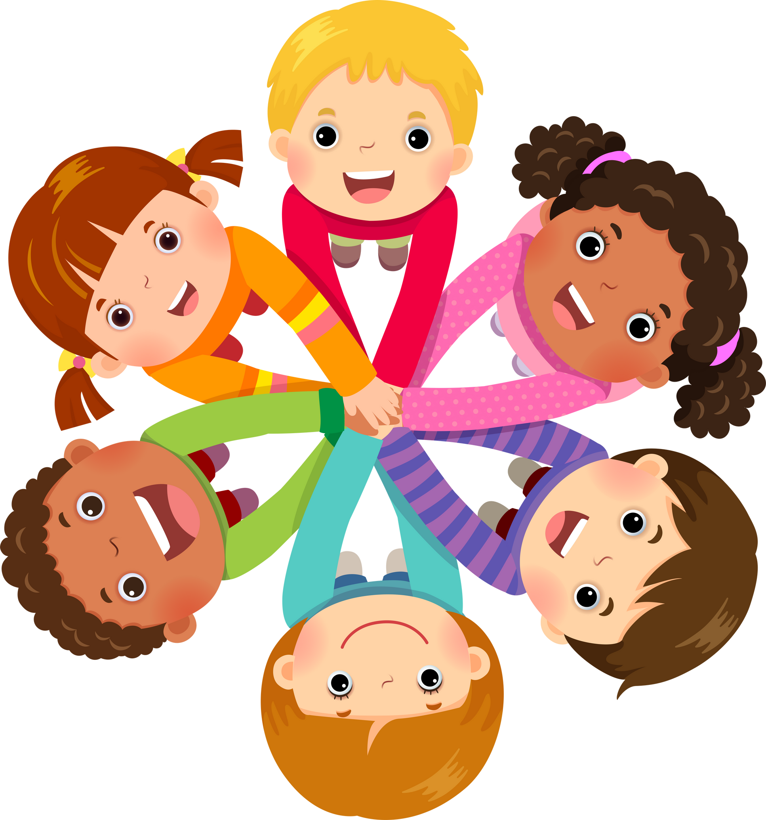
sharing ideas:
what do you do to support your child’s wellbeing?

Slide 13
almost done...
On a scale of 1 - 10, please rate yourself on the following statements:
1 2 3 4 5 6 7 8 9 10
Not confident
Very confident
I know the different things I can do to support my child’s wellbeing

Slide 14
Further support
School - good awareness of your child. They should be able to support your child’s learning and can connect you to services to help the family
  Ms Ince (Safeguarding Lead & Inclusion Lead), child’s class teacher
GP - well trained in physical & mental wellbeing. They are able to suggest ideas and treatment and can refer to specialist services
Young Minds - information supporting children struggling with their wellbeing and empowering families | www.youngminds.org.uk
Well Newham - list of organisations available to support parents in Newham | www.wellnewham.org.uk/advice/support-parents
Family Lives – parenting advice and family support on various issues across the child’s lifespan | Whatsapp, Live Chat, Helpline | www.familylives.org.uk

Slide 15
Thank you very much

